Slide 1
Chapter 6
MORTGAGE MARKETS

Slide 2
Chapter Preview
What Are Mortgages?
Characteristics of Residential Mortgages
Types of Mortgage Loans
Mortgage-Lending Institutions

Slide 3
Chapter Preview (cont.)
Loan Servicing
Secondary Mortgage Market
Securitization of Mortgages
The Impact of Securitized Mortgages on the Mortgage Market

Slide 4
References
Mishkin & Eakin, Financial Markets+Institutions, Ch11
Cecchetti, Stephen (2008), “Crisis and Responses: the Federal Reverse and the Financial Crisis of 2007-2008”, NBER Working Paper Series
Crotty, James and Gerald Epstein (2008), “Proposals for Effectively Regulation the U.S. Financial System to Avoid Yet Another Meltdown”, Working paper
Jonathan, Katz; Emanuel, Salinas, and Stephanou, Constantinos, “Credit Rating Agencies”
Murphy, Austin, “An Analysis of the Financial Crisis of 2008: Causes and Solutions”

Slide 5
What Are Mortgages?
A long-term loan secured by real estate
A fixed payment pays both principal and interest each month.

Slide 6
What Are Mortgages? Mortgage Loan Borrowers

Slide 7
What Are Mortgages? History
Mortgages were used in the 1880s, but massive defaults in the agricultural recession of 1890 made long-term mortgages difficult to attain.
Until post-WWII, most mortgage loans were short-term balloon loans with maturities of five years or less.

Slide 8
What Are Mortgages? History
Balloon loans, however, caused problems during the depression. Typically, the lender renews the loan. But, with so many Americans out of work, lenders could not continue to extend credit.
As a part of the depression recovery program, the federal government assisted in creating the standard 30-year mortgage we know today.

Slide 9
Characteristics of the Residential Mortgage
Mortgages can be roughly classified along the following three dimensions:
Mortgage Interest Rates
Loan Terms
Mortgage Loan Amortization

Slide 10
Characteristics of the Residential Mortgage: Mortgage Interest Rates
The stated rate on a mortgage loan is determined by three rates:
Market Rates: general rates on Treasury bonds
Term: longer-term mortgages have higher rates
Discount Points: a lower rates negotiated for cash upfront

Slide 11
Characteristics of the Residential Mortgage: Mortgage Interest Rates

Slide 12
Characteristics of the Residential Mortgage: Mortgage Interest Rates & Points
A difficult decision when getting a mortgage is whether to pay points (cash) upfront in exchange for a lower interest rate on the mortgage. Suppose you had to choose between a 12% 30-year mortgage or an 11.5% mortgage with 2 discount points. Which should you choose? Assume you wished to borrow $100,000.

Slide 13
Characteristics of the Residential Mortgage: Mortgage Interest Rates & Points
First, examine the 12% mortgage. Using a financial calculator, the required payments is:
n = 360, i = 1.0, PV = 100,000,
Calculate the PMT. PMT = $1,028.61

Slide 14
Characteristics of the Residential Mortgage: Mortgage Interest Rates & Points
Now, examine the 11.5% mortgage. Using a financial calculator, the required payments is:
n = 360, i = 11.5/12, PV = 100,000,
Calculate the PMT. PMT = $990.29

Slide 15
Characteristics of the Residential Mortgage: Mortgage Interest Rates & Points
So, paying the points will save you $38.32 each month. However, you have to pay $2,000 upfront.
You can see that the decision depends on how long you want to live in the house, keeping the same mortgage.

Slide 16
Characteristics of the Residential Mortgage: Mortgage Interest Rates & Points
If you only want to live there 12 months, clearly the $2,000 upfront cost is not worth the monthly savings.
Let’s see how to determine the answer.

Slide 17
Characteristics of the Residential Mortgage: Mortgage Interest Rates & Points
You need to determine when the present value of the savings ($38.32) equals the $2,000 upfront. Using a financial calculator, this is:
i = 1, PV = -2,000, PMT = 38.32
Calculate n. n = 74 months, or about 6.2 years.

Slide 18
Characteristics of the Residential Mortgage: Mortgage Interest Rates & Points
So, if you think you will stay in the house and not refinance for at least 6.2 years, paying the $2,000 for the lower payment is a sound financial decision.
Otherwise, you should accept the 12% loan.

Slide 19
Characteristics of the Residential Mortgage: Mortgage Interest Rates & Points
The next table further illustrates this point, showing the effective rate on the 11.5% mortgage if the mortgage is paid in full at various points.
Note that right around year 6, the effective annual rate on the 11.5% mortgage is about the same as effective annual rate on the 12% mortgage (12.68%).

Slide 20
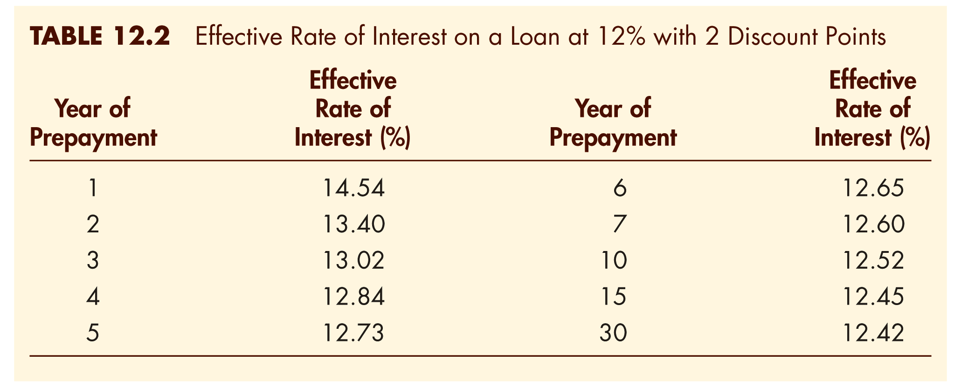
Characteristics of the Residential Mortgage: Effective Rate of Interest

Slide 21
Characteristics of the Residential Mortgage: Loan Terms
Mortgage loan contracts contain many legal terms that need to be understood. Most protect the lender from financial loss.
Collateral: usually the real estate being finance
Down payment: a portion of the purchase price paid by the borrower

Slide 22
Characteristics of the Residential Mortgage: Loan Terms
Mortgage loan contracts contain many legal terms that need to be understood. Most protect the lender from financial loss.
PMI: insurance against default by the borrower
Qualifications: includes credit history, employment history, etc., to determine the borrowers ability to repay the mortgage as specified in the contact
Notes:
Private Mortgage Insurance

Slide 23
Characteristics of the Residential Mortgage: Loan Terms
Lenders will also order a credit report from one of the credit reporting agencies.
The score reported is called the FICO.
The range is 300 to 850, with 660 to 720 being average.
Payment history, debt, and even credit card applications can affect your credit score.

Slide 24
Characteristics of the Residential Mortgage: Loan Amortization
Mortgage loans are amortized loans. This means that a fixed, level payment will pay interest due plus a portion of the principal each month. It is designed so that the balance on the mortgage will be zero when the last payment is made.
The next table shows a typical amortization table for a 30-year mortgage at 8.5%.

Slide 25
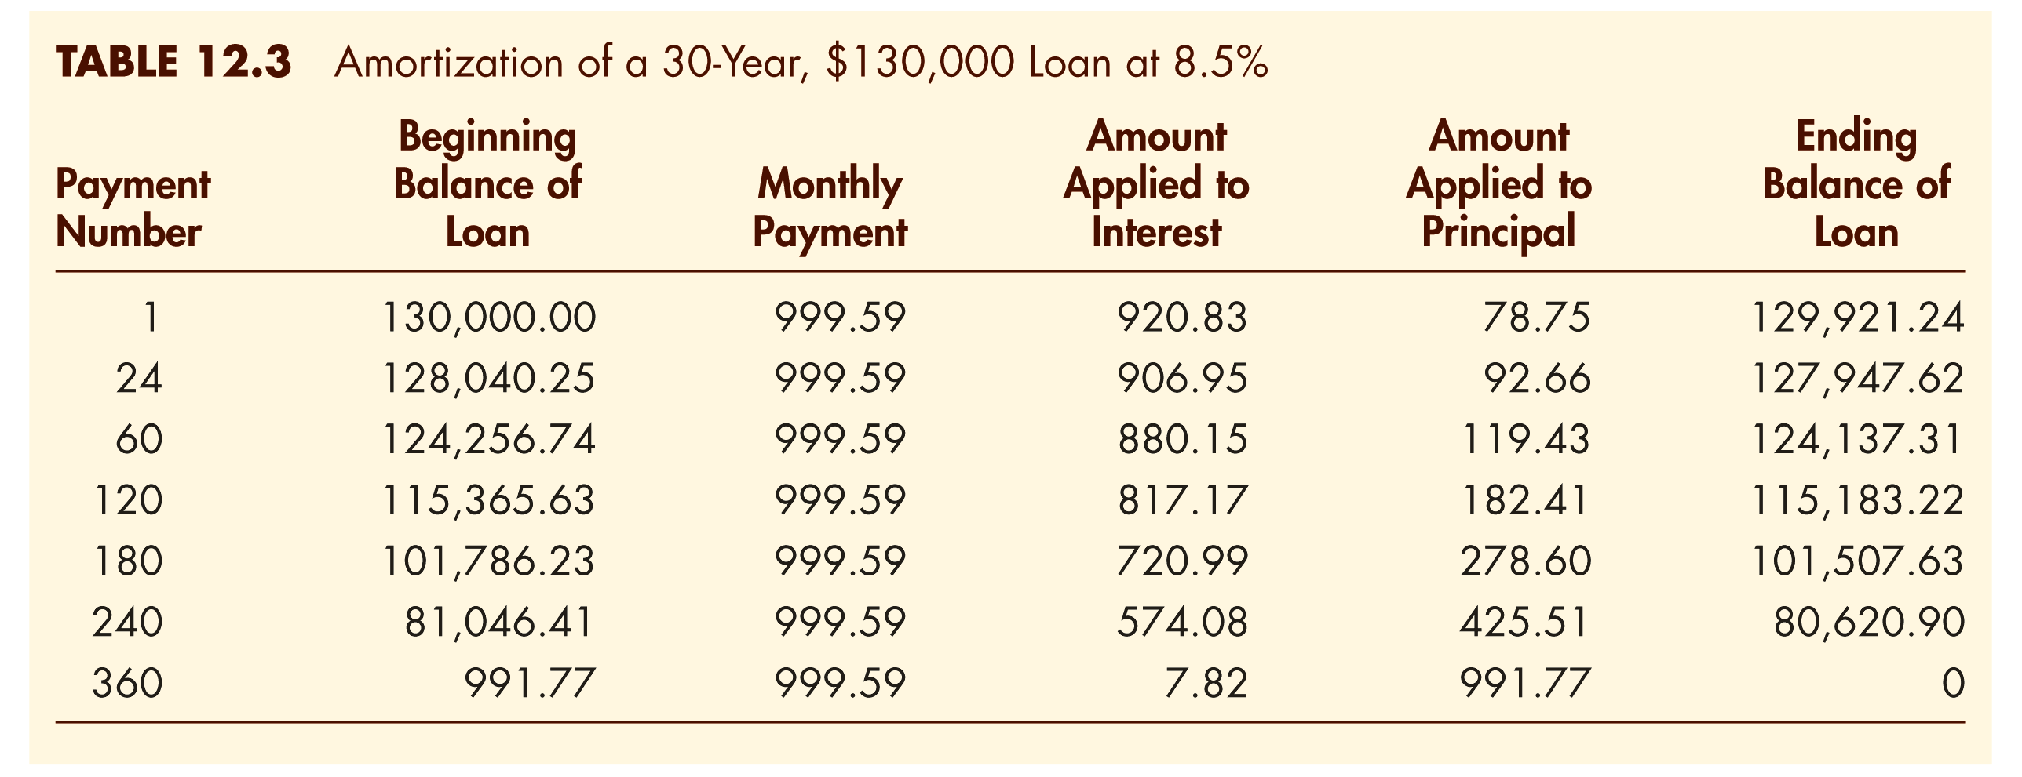
Characteristics of the Residential Mortgage: Loan Amortization Schedule

Slide 26
Types of Mortgage Loans
Insured vs. Conventional Mortgages: if the down payment is less than 20%, insurance is usually required
Fixed-Rate Mortgages: the interest rate is fixed for the life of the mortgage
Adjustable-Rate Mortgages: the interest rate can fluctuate within certain parameters

Slide 27
Types of Mortgage Loans
Other Types
Graduated-Payment Mortgages (GPMs)
Growing Equity Mortgages (GEMs)
Shared-Appreciation Mortgages (SAMs)
Equity Participation Mortgages
Second Mortgages
Reverse Annuity Mortgages (RAMs)
The following table lists additional characteristics on all the loans.

Slide 28
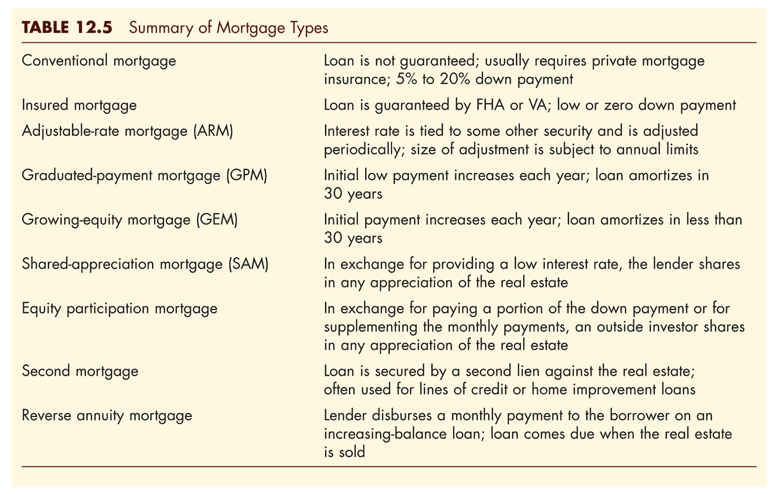
Types of Mortgage Loans

Slide 29
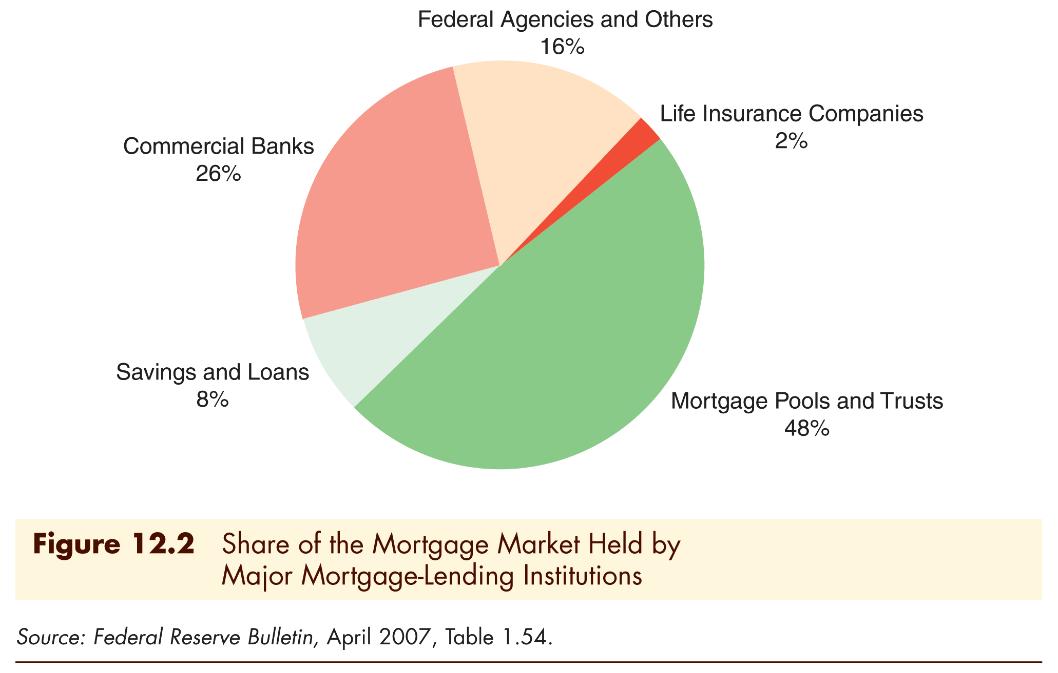
Mortgage-Lending Institutions

Slide 30
Loan Servicing
Three distinct elements in mortgage loans:
The originator packages the loan for an investor
The investor holds the loan
The servicing agent handles the paperwork

Slide 31
Loan Servicing
Many of the institutions making mortgage loans do not want to hold large portfolios of long-term securities. Commercial banks, for example, obtain their funds from short-term sources. Investing in long-term loans would subject them to unacceptably high interest-rate risk.
Most loan originators do make money through the fees that they earn by packaging loans for other investors to hold. Loan origination fees are typically 1% of the loan amount, though this varies with the market.
Someone have to collect the monthly payments and keep records. This is known as loan servicing, and servicers usually keep a portion of the payments received to cover their costs.

Slide 32
Secondary Mortgage Market
The secondary mortgage market was originally established by the federal government after WWII when it created Fannie Mae to buy mortgages from thrifts.
The market experienced tremendous growth in the early to mid-1980, and has continued to remain a strong market in the U.S.

Slide 33
Securitization of Mortgages
Intermediaries still faced several problems when trying to sell mortgages:
Mortgages are usually too small to be wholesale instruments.
Mortgages in the secondary market are not standardized: different times to maturity, interest rates, and contract terms. It is difficult to bundle a large number of mortgages together.
Mortgage loans are relatively costly to service. The lender must collect monthly payments, often pay property taxes and insurance premiums, and service reserve accounts. None of this is required if a bond is purchased.
Mortgages have unknown default risk. Investors in mortgages do not want to expend energy evaluating the credit of borrowers.
These problems inspired the creation of the mortgage-backed security, also known as a securitized mortgage.

Slide 34
Securitization of Mortgages
An alternative to selling mortgages directly to investors is to create a new security backed by (secured by) a large number of mortgages assembled into what is called a mortgage pool. A trustee, such as a bank or a government agency, holds the mortgage pool, which serves as collateral for the new security. This process is called securitization.
Mortgage pass-through, a security that has the borrower’s mortgage payments pass through the trustee before being disbursed to the investors in the mortgage pass-through.
This design did eliminate some risk, but investors still face prepayment risk.

Slide 35
Securitization of Mortgages: CMOs
Definition: A CMO is a structured MBS where investor pools have different rights to different sets of cash flows.
This design structured the prepayment risk. Some classes had little, while other had a lot.
Notes:
Collateralized Mortgage Obligation - CMO

Slide 36
Mortgage Pools

Slide 37
The Impact of Securitization on the Mortgage Market
Benefits
Reduces the problems caused by regional lending institution’s sensitivity to local economic fluctuations
Borrowers have access to a national capital market
Investors have low-risk and long-term investments in mortgages without having to service the loan

Slide 38
The Impact of Securitization on the Mortgage Market
However, this is not without its costs. Because of securitization, mortgage rates have become more national in nature, and this has led to increased volatility in mortgage rates.

Slide 39
The Subprime Mortgage Market
In 2000, only 2% of mortgages were subprime. This climbed to 17% by 2006.
The average FICO score was 624 for subprime borrowers. Prime mortgage borrowers were 742.
Mortgage products became more complicated, and income requirements for these mortgages became very lax.

Slide 40
The Subprime Mortgage Market
Subprime mortgages have become quite controversial. Although predatory advertising and “bait and switch” tactics were all-too-common, home ownership did increase because of subprime lending.

Slide 41
End of Chapter 6

